Slide 1
PART 1 – MATERIALIZED VIEW

Slide 2
Using materialized views, it is possible to pre calculate complex joins and execute the aggregate operation i.e summary data and also stores the result set of the table in the database.
In future the end users may query the table and views the detail information.
The query rewrite mechanism in the Oracle server automatically rewrites the SQL query to use the summary tables.
This technique improves the query execution time and performance.

Slide 3
create table item(itemno number(3) primary key ,iname varchar2(10),price number(4));
insert into item values(1,'milk',20);
insert into item values(2,'Bread',30);
insert into item values(3,'Juice',40);
Table | Materialized View
select itemno,Iname from item ; | create materialized view mv as select itemno,iname from item; select * from MV ;
ITEMNO INAME ------ ----- 1 milk 2 Bread 3 Juice | ITEMNO INAME ------- ----- 1 milk 2 Bread 3 Juice

Slide 4
A materialized view is a database object.
It is physically stored in the database.
Because materialized view tables are having local copies of data suppose base table is located remotely.
It is also useful to create summary table based on aggregation of the base table data.
The materialized view stores both query and the result of a query.

Slide 5
Table | Materialized View
update item set iname = upper(iname);
select itemno,iname from item ; | select * from MV ;
ITEMNO INAME ---------- ---------- 1 MILK 2 BREAD 3 JUICE | ITEMNO INAME ------- ----- 1 milk 2 Bread 3 Juice
The reason for materialized view is not reflecting the updation of base table is, materialized view storing the copy of data in a separate physically place in the database. i.e. both have different Rowid
Rowid is the physical address for each record in the database and it is a fixed-length binary data

Slide 6
To apply
refresh technique
to
materialized view table
for synchronize With
base table data.
Refresh complete,
Refresh Fast,
Refresh Force

Slide 7
PART 2
Mode of Refresh Technique

Slide 8
Mode of Refresh
ON DEMAND
ON COMMIT
By default mode, it need manual refresh execution procedure
Automatic refresh, no need of execute refresh procedure

Slide 9
There is two mode of refresh technique is available, one is “REFRESH ON DEMAND” and other one is “REFRESH ON COMMIT”.
create materialized view mv as select itemno,iname from item; | = | create materialized view mv REFRESH ON DEMAND as select itemno,iname from item;
Table | Materialized View
update item set iname = upper(iname);
select itemno,iname from item ; | select * from MV ;
ITEMNO INAME ---------- ---------- 1 MILK 2 BREAD 3 JUICE | ITEMNO INAME ------- ----- 1 milk 2 Bread 3 Juice

Slide 10
For matching updating of data in materialized view table (mv) and base table (item), the refresh procedures are available in the DBMS_MVIEW package.
When execute the refresh procedure, the materialized view table (mv) synchronized with base table (item)
SQL> execute dbms_mview.refresh( 'MV' ); PL/SQL procedure successfully completed.
Table | Materialized View
select * from item; | select itemno,iname from MV ;
ITEMNO INAME ------ ---------- 1 MILK 2 BREAD 3 JUICE | ITEMNO INAME ------ -------- 1 MILK 2 BREAD 3 JUICE

Slide 11
The other method is called “ REFRESH ON COMMIT”, Unlike manual refresh method, it doesn’t need “DBMS_MVIEW.REFRESH” to execute.
Create materialized view mv refresh on commit as select * from item;
Select itemno,iname from mv ITEMNO INAME --------- --------- 1 Fruits 2 COFFEE 8 Biscutts 5 rice

Slide 12
Insert into item values(3,’Water’)
Commit;
select * from item; ITEMNO INAME ---------- ---------- 3 Water 1 Fruits 2 COFFEE 8 Biscutts 5 rice | Select itemno,iname from mv; ITEMNO INAME ------- ----------- 1 Fruits 2 COFFEE 8 Biscutts 5 rice 3 Water
It automatically refreshed, after commit statement. i.e it is synchronized with base table data just by “COMMIT” statement.

Slide 13
PART 3
Introduction
Of
Refresh option

Slide 14
Create Materialized view using Refresh options
Method =>’C’
Method =>’F’
Method =>’ ?’
Refresh complete
Refresh Fast
Refresh Force
Never Refresh
No Need to mention method “F” in the Execute statement.
execute
ALTER MV into refresh complete, refresh fast, refresh force
Method =‘C’
Method =‘F’
Execute statement must be
method =>’C’
otherwise error occur
It don’t create new result set in different row id, same existing row id
It create new result set, with new row id
System decides based on situation it will automatically assign either ‘C’ or ‘F’
User specifying saying Method either ‘C’ or ‘F’

Slide 15
PART 4
Refresh Complete

Slide 16
SQL> create materialized view mv2 refresh complete as select * from item;
Before Execute | After Execute using “C” method
select rowid,itemno,iname from mv2; | execute DBMS_MVIEW.REFRESH(LIST => 'MV2', method=>'c'); select rowid,itemno,iname from mv2;
ROWID ITEMNO INAME AAAMEQAAEAAAAB0AAA 1 MILK AAAMEQAAEAAAAB0AAB 2 BREAD AAAMEQAAEAAAAB0AAC 3 JUICE | ROWID ITEMNO INAME-AAAMEQAAEAAAAB0AAD 1 MILK AAAMEQAAEAAAAB0AAE 2 BREAD AAAMEQAAEAAAAB0AAF 3 JUICE
When a refresh complete occurs in the materialized view's defining query is executed and the complete result set replaces the data currently existed in the materialized view.
As a result, it completely re-creates the result set of the materialized view
The rowids after execute differs from the before execute, even though the data in base table ITEM was unchanged

Slide 17
execute DBMS_MVIEW.REFRESH(LIST => 'MV2', METHOD => 'C' );
The "list" parameter accepts a list of materialized views to refresh (i.e “mv2”) and the "method" parameter accepts a "C", for Complete refresh. (i.e ‘C’ means Complete refresh)
The limitation of refresh complete is , suppose if a materialized view have many rows and the base tables values are changed infrequently then refresh complete is time-consuming method or over slow.
Another issue is due to bad connections sometimes the refresh completes never finishing their process.

Slide 18
PART 5
Refresh Fast

Slide 19
REFRESH FAST clause used in the CREATE MATERIALIZED VIEW command tells the oracle suppose no need to mention refresh option in the execution.
The above statement is not mentioning any “method =>’F’, but create materialized view “mv” is using refresh fast. So, the default refresh method in the execute statement refresh fast only
create materialized view MV refresh fast as select * from item;
Execute dbms_mview.refresh( 'MV' );

Slide 20
create materialized view mv refresh fast as select * from item;
Before Execute | After Execute using “F” method
select rowid,itemno,iname from mv; | execute DBMS_MVIEW.REFRESH(LIST => 'MV', method=>'F'); select rowid,itemno,iname from mv;
ROWID ITEMNO INAME AAAMEQAAEAAAAB0AAA 1 MILK AAAMEQAAEAAAAB0AAB 2 BREAD AAAMEQAAEAAAAB0AAC 3 JUICE | ROWID ITEMNO INAME AAAMEQAAEAAAAB0AAA 1 MILK AAAMEQAAEAAAAB0AAB 2 BREAD AAAMEQAAEAAAAB0AAC 3 JUICE
update item set iname='JAM' where itemno=3 execute DBMS_MVIEW.REFRESH('MV’');
select rowid,itemno,iname from mv;
ROWID ITEMNO INAME -----------------------------------------------------------------------------------------------------AAAMEQAAEAAAAB0AAA 1 MILK AAAMEQAAEAAAAB0AAB 2 BREAD AAAMEQAAEAAAAB0AAC 3 JAM
The benefit of using REFRESH FAST is, it don’t create entire new result set using new rowid like REFRESH COMPLETE.
The value was updated in the materialized view without changing the “Rowid”.

Slide 21
PART 6
Refresh Force

Slide 22
“REFRESH FORCE” clause to decide which performance is most appropriate for query rewrite using DML operation either refresh fast or refresh complete based on the Operation.
Create materialized view mv3 refresh force as select max(itemno) as max from item;
SQL> select rowid,max from mv3; ROWID MAX -----------------------------------------------------------------------------------AAAMFEAAEAAAACMAAA 6
update item set iname='jam' where itemno=6;
execute dbms_mview.refresh('mv3‘, method=>’?’);
SQL> select rowid,max from mv3; ROWID MAX --------------------------------------- ---------- AAAMFEAAEAAAACMAAB 6
the update operation in the materialized and after execute it changes the rowid; here refresh force performs the refresh complete method.

Slide 23
Create materialized view mv3 refresh force as select itemno,iname from item where itemno>4;
SQL> select rowid,itemno,iname from mv3; ROWID ITEMNO INAME ----------------------------------- --------- ---------- AAAMFGAAEAAAACMAAA 5 water AAAMFGAAEAAAACMAAB 6 jam
update item set iname='pepsi' where itemno=5;
execute dbms_mview.refresh('mv3');
SQL> select rowid,itemno,iname from mv3; ROWID ITEMNO INAME ------------------------------------------------------------ ------------------------------ AAAMFGAAEAAAACMAAA 5 pepsi AAAMFGAAEAAAACMAAB 6 jam
update operation are executed, here Rowid is not changing. The refresh force is performing the “Refresh fast”

Slide 24
PART 7
Never Refresh
using
ALTER Refresh complete

Slide 25
Oracle Database will ignore any REFRESH statement on the materialized view and prevents any refresh method such as FAST or COMPLETE by using NEVER REFRESH in create materialized view statement.
Create materialized view mv3 never refresh as select itemno,iname from item where itemno>4;
SQL> select rowid,itemno,iname from mv3; ROWID ITEMNO INAME -------------------------------------- ---------- ---------- AAAMFJAAEAAAACMAAA 5 pepsi AAAMFJAAEAAAACMAAB 6 jam
SQL> update item set iname='water' where itemno=5;
SQL> execute dbms_mview.refresh('mv3');
BEGIN dbms_mview.refresh('mv3'); END; *ERROR at line 1:ORA-23538: cannot explicitly refresh a NEVER REFRESH materialized view ("MV3") ORA-06512: at "SYS.DBMS_SNAPSHOT", line 1883 ORA-06512: at "SYS.DBMS_SNAPSHOT", line 2089 ORA-06512: at "SYS.DBMS_SNAPSHOT", line 2058

Slide 26
Alter the materialized view into refresh complete and then execute the materialized view.
Now, I don’t give error message.
alter materialized view mv3 refresh complete;
execute dbms_mview.refresh('mv3');
SQL> select rowid,itemno,iname from mv3; ROWID ITEMNO INAME ------------------------------------------------------------------------------------------- AAAMFJAAEAAAACMAAC 5 water AAAMFJAAEAAAACMAAD 6 jam

Slide 27
PART 8
Never Refresh
using
ALTER Refresh Fast

Slide 28
Instead of altering materialized view into refresh complete, alter into refresh fast.
Then try any DML operations, it gives the error.
The reason is, it alters the materialized view into “read-only" type.
So, it doesn’t allow any DML operation.
In this case, call “refresh complete” for execution. Complete refresh creates the entirely new set.

Slide 29
alter materialized view mv3 refresh fast;
execute dbms_mview.refresh('mv3');
Insert into item values(8,’Biscutts’)
BEGIN dbms_mview.refresh('mv3'); END;*ERROR at line 1: ORA-12057: materialized view "SCOTT"."MV3" is INVALID and must complete refresh ORA-06512: at "SYS.DBMS_SNAPSHOT", line 1883 ORA-06512: at "SYS.DBMS_SNAPSHOT", line 2089 ORA-06512: at "SYS.DBMS_SNAPSHOT", line 2058 ORA-06512: at line 1
execute dbms_mview.refresh( list => 'MV3',method=>'c');
SQL> select rowid,itemno,iname from mv3; ROWID ITEMNO INAME ------------------ ---------- ---------- AAAMFJAAEAAAACMAAE 5 water AAAMFJAAEAAAACMAAF 6 jam AAAMFJAAEAAAACMAAG 8 Biscutts

Slide 30
PART 9
Never Refresh
using
ALTER Refresh Force

Slide 31
Create materialized view mv3 never refresh as select itemno,iname from item where itemno>4;
alter materialized view mv3 refresh force;
select rowid,itemno,iname from mv3; ROWID ITEMNO INAME ----------------------------------- ---------- ---------- AAAMFPAAEAAAACMAAA 5 Lemon AAAMFPAAEAAAACMAAB 8 Biscutts
update item set iname='rice' where itemno=5;
SQL> execute DBMS_MVIEW.REFRESH(LIST => 'MV3',method=>'?');
SQL> select rowid,itemno,iname from mv3; ROWID ITEMNO INAME ------------------------------------- ---------- ---------- AAAMFPAAEAAAACMAAC 5 rice AAAMFPAAEAAAACMAAD 8 Biscutts

Slide 32
Alter the materialized view from never fresh into refresh force, now execute the update operation.
In the execute statement, the method “?” means refresh force.
But refresh force applies only refresh complete method, not refresh fast.
It shows in the result set that “rowid” has changed

Slide 33
PART 10
Create Materialized view Log
MLOG$

Slide 34
As seen earlier topic, complete refresh is time-consuming and occupying storage space.
These drawbacks are rectified by applying Materialized View Log
The materialized view captures only the changed rows occur in the base table, it don’t captures the entire value.
This technique is called Materialized View Log and “incremental" refreshing
Usually, a Materialized View Log takes less time than a complete refresh.

Slide 35
DESC ITEM; Name Null? Type ----------------------------------------- -------- ---------------------------- ITEMNO NOT NULL NUMBER(3) INAME VARCHAR2(10)
create materialized view log on item;
In this materialized view log, the name for materialized view is not given name.
For example in the previous materialized view used “mv”, “mv2" like that.
Because a base table has only one materialized view log related at a time, so a separate materialized view name is not required.

Slide 36
describe MLOG$_item; Name Null? Type ----------------------------------------- -------- ---------------------------- ITEMNO NUMBER(3) SNAPTIME$$ DATE DMLTYPE$$ VARCHAR2(1) OLD_NEW$$ VARCHAR2(1) CHANGE_VECTOR$$ RAW(255)
Once materialized view log was created, it automatically generates a log file called MLOG$_<base table>
The MLOG$_item.itemno column copy the base table’s primary key column item.itemno.
The MLOG$ also uses in the primary key column data type and size is as same as base table item i.e data type is NUMBER(3).
The other MLOG$ columns are system generated for example SNAPTIME$$, DMLTYPE$$,OLDNEW$$,CHANGE_VECTOR$$.

Slide 37
PART 11
Materialized view Log
DMLTYPE$$

Slide 38
Materialized view log is initially empty.
select * from MLOG$_ITEM; no rows selected
UPDATE ITEM set INAME=‘COFFEE’ where ITEMNO = 2 ; INSERT into ITEM(ITEMNO,INAME)values (4,’Biscutts’); select itemno, dmltype$$ as dmltype from MLOG$_item;
ITEMNO D -------------------- 2 U 4 I
Rows are automatically added to MLOG$_ITEM when base table ITEM is executed by any DML operation such that UPDATE, DELETE or INSERT.
The result of the MLOG$_item, shows number of changes occur in the base table. Here “U” – update operation in itemno 2 and “I”- insert operation occurred in itemno 4 in the base table item.

Slide 39
Suppose, if rollback all the DML operation executed in the base table, the MLOG$_ITEM is again empty.
The changes are not committed in the base table item.
rollback ; select itemno, dmltype$$ from MLOG$_item; no rows selected
The materialized view log is using “on commit” by default. That is a reason it don’t need execute any “DBMS_MVIEW.REFRESH” procedure to initiate the refresh in the materialized view.

Slide 40
DESC ITEM; Name Null? Type ----------------------------------------- -------- ---------------------------- ITEMNO NOT NULL NUMBER(3) INAME VARCHAR2(10)
drop materialized view log on item ; create materialized view log on item WITH PRIMARY KEY ;
desc mlog$_item;
Name Null? Type --------------------------------------------------------------- ITEMNO NUMBER(3) SNAPTIME$$ DATE DMLTYPE$$ VARCHAR2(1) OLD_NEW$$ VARCHAR2(1) CHANGE_VECTOR$$ RAW(255)

Slide 41
PART 12
COMMENTS
ON
Materialized view

Slide 42
It is possible to add comment in materialized view.
This comment statement added into the data dictionary for the already existing materialized view table.
The comment table has three columns in the data dictionary regarding the materialized view:
Owner - owner of the materialized view
Mview_name - materialized view name
Comments -Comment on the materialized view
SQL> comment on materialized view mv is 'ITEM Information';
Comment created.
SELECT MVIEW_NAME, COMMENTS FROM USER_MVIEW_COMMENTS WHERE MVIEW_NAME = ‘MV';
MVIEW_NAME COMMENTS ------------------------------------------------ MV ITEM Information

Slide 43
There is three types of comment view are available in the data dictionary for materialized view.
USER_MVIEW_COMMENTS display the current user comments on the materialized views. This view does not display the OWNER column. It will display only Mview_name, comments column.
DBA_MVIEW_COMMENTS displays the database comments on the materialized views. It will display all the three columns such as owner, mview_name, comments.
ALL_MVIEW_COMMENTS displays all the current user comments on the materialized view. It will display all the three columns such as owner, mview_name, comments.

Slide 44
SELECT OWNER, MVIEW_NAME, COMMENTS FROM ALL_MVIEW_COMMENTS;
OWNER MVIEW_NAME COMMENTS ---------------------------------------------------------- SCOTT MV1 Snapshot table for snapshot SCOTT.MV1 SCOTT MV ITEM Information SCOTT MV2 ITEM DESCRIPTION
Drop comments on materialized view
Syntax:
Comment on materialized view <name of the materialized view> is ‘< within single code give blank space>‘;
SQL>comment on materialized view mv is ' ';

Slide 45
PART 13
Materialized view Using
“For Update”

Slide 46
By default materialized view tables are read-only.
Suppose tried with DML operation in the materialized view table causes the error message
SQL> INSERT into mv(ITEMNO,INAME)values (5,'Chocolate');
INSERT into mv(ITEMNO,INAME)values (5,'Chocolate')
*
ERROR at line 1:
ORA-01732: data manipulation operation not legal on this view
Suppose materialized view is created using FOR UPDATE clause, then it enables DML operations directly in the materialized view.
This type of materialized view is called updatable materialized view.

Slide 47
SQL> drop materialized view mv; SQL> create materialized view mv for update as select itemno,iname from item;
SQL> select itemno,iname from item; ITEMNO INAME ---------- ---------- 1 MILK 2 COFFEE 3 JUICE 4 Biscutts | SQL> select itemno,iname from mv; ITEMNO INAME ---------- ---------- 1 MILK 2 COFFEE 3 JUICE 4 Biscutts
The data in the materialized view table “mv” and base table “item” are identical.
Now insert one record only in materialized view not in the base table “item”
SQL> INSERT into mv(ITEMNO,INAME)values (5,'Chocolate');
SQL> select itemno,iname from mv; ITEMNO INAME ---------- ---------- 1 MILK 2 COFFEE 3 JUICE 4 Biscutts 5 Chocolate | SQL> select itemno,iname from item; ITEMNO INAME ---------- ---------- 1 MILK 2 COFFEE 3 JUICE 4 Biscutts

Slide 48
The materialized view table “mv” is not matching with “item” base table.
Because materialized view stores the copy of the result i.e ROWID is different than ROWID of the item table.
So, it is not matching with base table result.
To overcome this difficulty, it is necessary to execute refresh method in materialized view.

Slide 49
PART 14
Materialized view Using
Aggregate Function

Slide 50
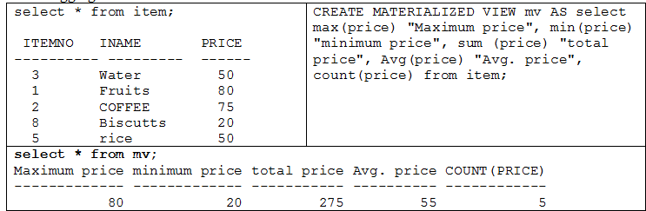
In the data warehousing environment the materialized views normally include aggregates. In the materialized view containing aggregates is possible after any type of DML to the base tables. In this example using MIN, MAX, SUM, AVG, COUNT aggregate function.

Slide 51
PART 15
Join Materialized view

Slide 52
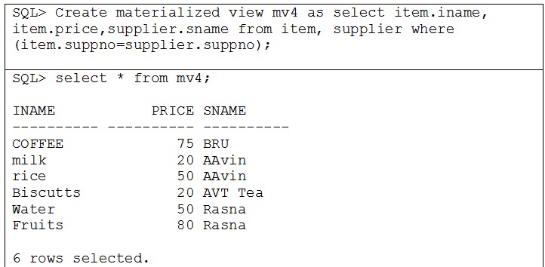
The Join has two tables. In the example used two tables namely Item and Supplier. The row in the one table always match with row of the another table. Here, no data will be lost i.e it is called lossless join. The table should have Primary key, Foreign Key and Not Null constraints on appropriate Join keys.

Slide 53
PART 16
View
Vs.
Materialized view

Slide 54
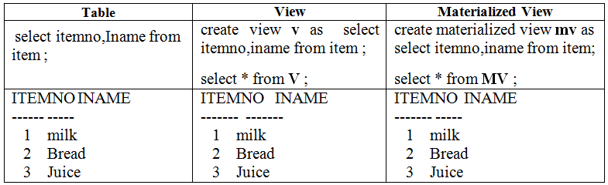
A view is a logical entity or virtual table.
The view is attached with SQL statement or query, which will store in the database in the system table space. It is used as similar like database table or base table (i.e item table).
Whenever query is fired against the database table or base table (i.e. item table), The view “v” execute the stored SQL statement ( i.e. select * from item) and creates a temporary table in the memory.
It do not stores the query result, it only execute and return the result /output. It means it will store only query not result.

Slide 55
A materialized view is a database object. It is physically stored in the database.
Because materialized view tables are having local copies of data suppose base table is located remotely.
It is also useful to create summary table based on aggregation of the base table data.
The materialized view stores both query and the result of a query.

Slide 56
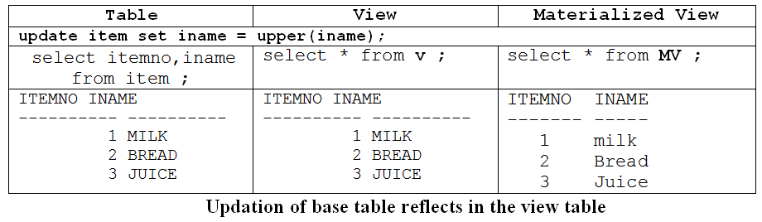
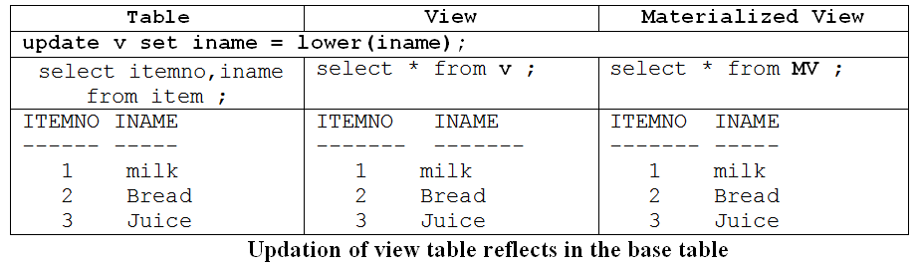
Whenever update the base table (item table), the view also automatically update the change. Otherwise update the view (“v”), the base table (item table) also automatically modifies the changes. For example after the update, the view data matches the table data but the materialized view data does not.

Slide 57
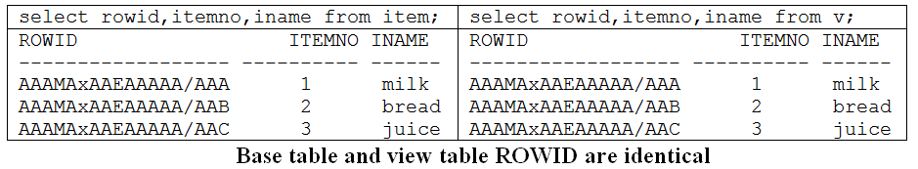
Base table and view table Rowid’s are same
Both base table and view table are identical, since both the base table and view table “Rowid’s” are same.
Rowid is the physical address for each record in the database and it is a fixed-length binary data.
So, it returns the same value and also any one table is updated the other table automatically returns the exact same result.

Slide 58
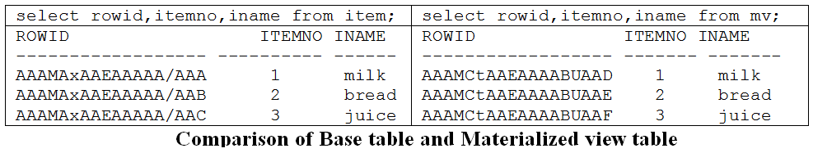
The reason for materialized view is not reflecting the updation of base table like view is, materialized view storing the copy of data in a separate physically place in the database.
The given below table clearly shows base table rowid and materialized view rowid are not same.

Slide 59
PART 17
Materialized view Build Methods

Slide 60
Materialized view Build Methods
BUILD IMMEDIATE
BUILD DEFERRED
create Materialized view, don’t store result of the materialized view Query
By Default, create Materialized view + stores the result of the statement.
For getting materialized view result there is two ways
Adding the definition of the materialized view into the schema object in the data dictionary.
Alter materialized view as refresh complete + enable query rewrite + refresh
execute dbms_mview.refresh('mv2',method=>'c');
Alter materialized view mv3 refresh complete enable query rewrite;
execute dbms_mview.refresh('mv3');

Slide 61
For creating materialized view, there is two build methods are used in the materialized view.
One is BUILD IMMEDIATE and another one is BUILD DEFERRED.
The BUILD IMMEDIATE method, it creates the materialized view and adding the definition of the materialized view into the schema object in the data dictionary.
And also search the base table according to the query given in the materialized view (i.e SELECT statement) and stores their result in the materialized view.

Slide 62
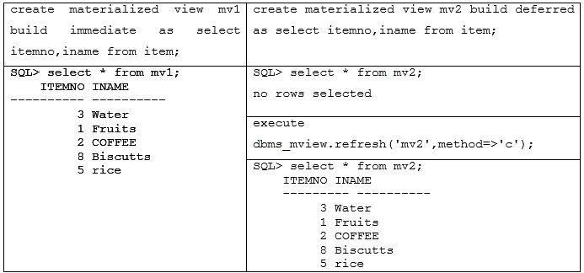

Slide 63
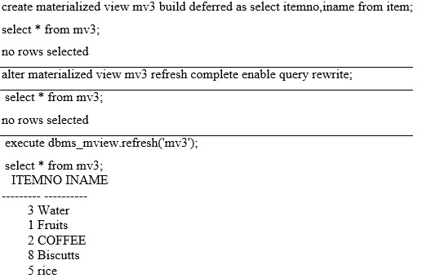
The build method clause is BUILD DEFERRED, it just creates the materialized view but it don’ search and store the result in the materialized view.
This method disables the query rewrite, so first time materialized view is executed by refresh complete method “C” using DBMS_MVIEW_REFRESH statement and then it automatically it will enable the materialized view by specifying the ENABLE QUERY REWRITE clause.

